Slide 1
Intro to Design Patterns
Lecture 3.1 – Factory Method Pattern

Slide 2
Reading
DPE
Chapter 23 – The Factory Method Pattern
Alexander
Notes:
Ask who read Alexander? What did you think?

Slide 3
If the Classes are varying use the Factory Method pattern
Technique
Public static function to instantiate derived classes.
Typically, all public methods are virtual.
Client asks Factory for object of base type, but Factory selects and returns derived type.
Benefits
Client code uses classes polymorphically.
Follows open/closed principle.
Follows DRY principle.
Alternatives suffer from strong coupling, code duplication, multiple seam points, violate open/closed principle.

Slide 4
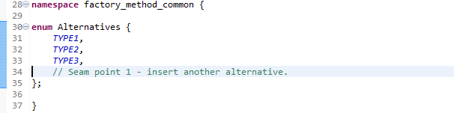
Code Common to the Examples

Slide 5
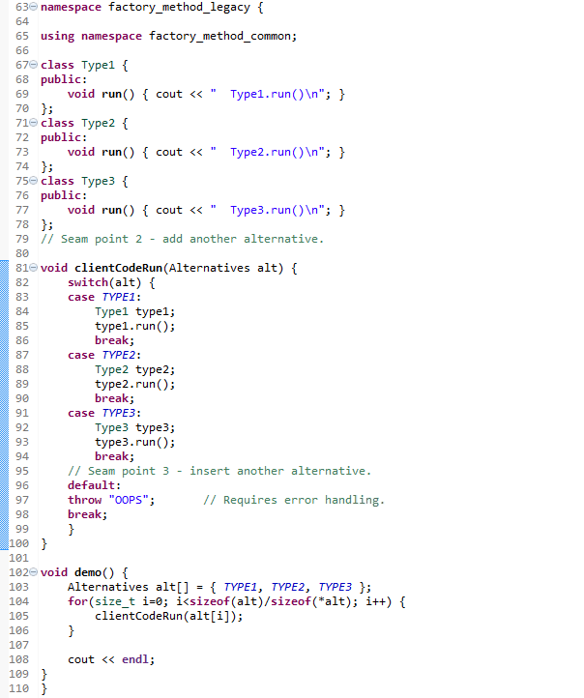

Legacy Example
A 3rd seam point, violates open/closed principle.
Verbose.
Requires error handling.
Scales badly if new methods required.

Slide 6
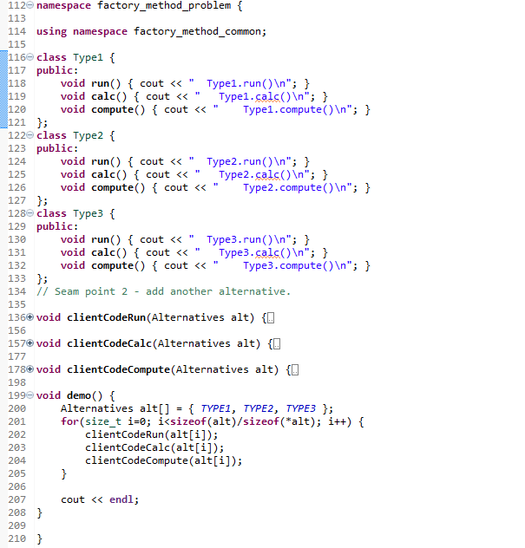
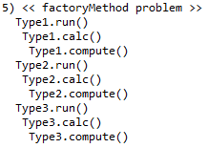
Problem Example
Strong, hidden coupling.
Similar conditionals a code smell.
Multiple seam points.
Requires error handling.
Notes:
New specs, adding new capabilities to the classes, in this case, methods calc() and compute().

Slide 7
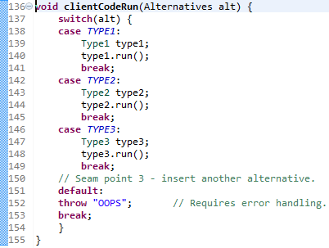
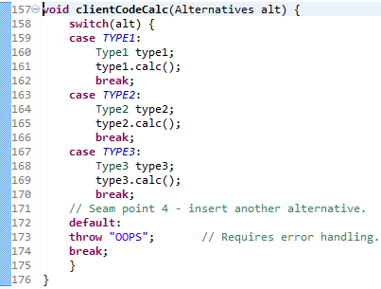
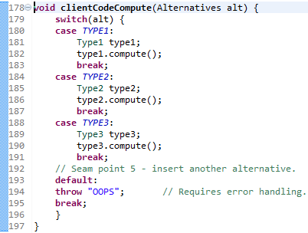
Open/Closed, DRY, Coupling

Slide 8
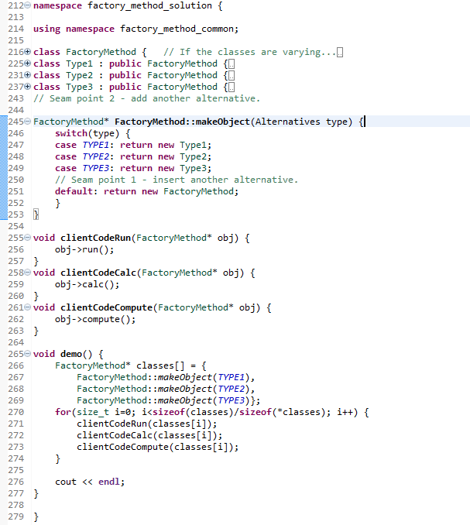
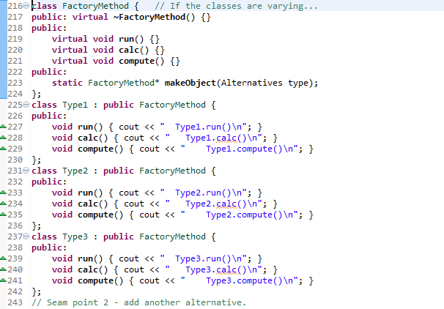
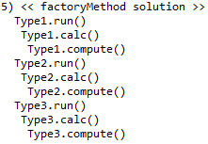
Solution Example
Notes:
Note the single switch statement, objects created by factory rather than ctor.
Client code is much simpler, polymorphic.

Slide 9
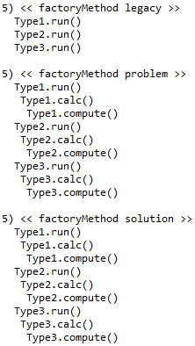
Output

Slide 10
Homework
Problem: Sending encrypted video streams
What varies
Display types (DisplayPort, HDMI, MIPI, Widi) (HEVC)
Crypto protocols (PVP, ID1, RSE) (RDX)
Resolutions ([640,480], [1920,1080]) ([3840,2160])
Frame rates (48, 50, 60) (75, 120)
Model as
Frame rates as integers.
Resolutions as a pair of integers (POD).
Display types & Crypto protocols as class hierarchies.

Slide 11
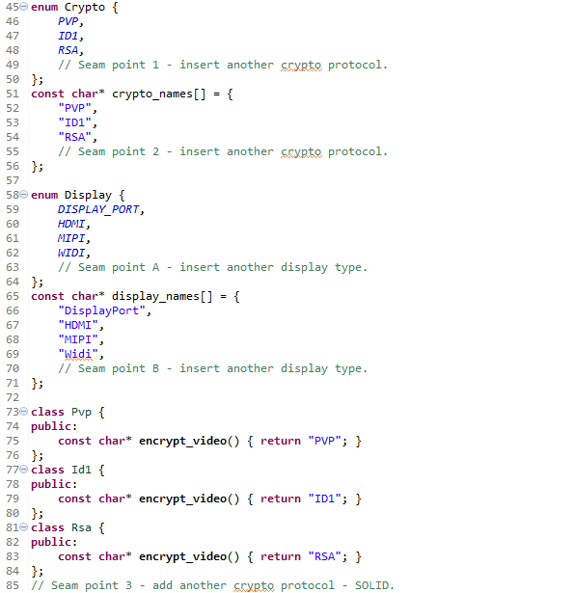
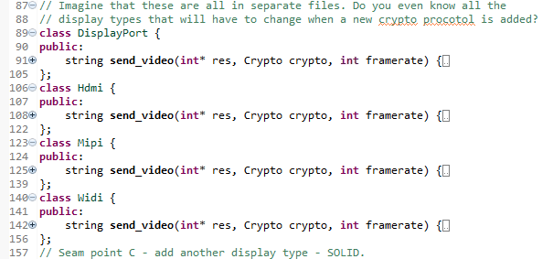
Example Problem
Separate classes for all display types and crypto protocols.

Slide 12
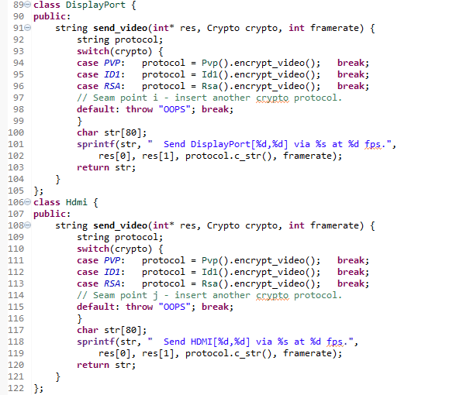
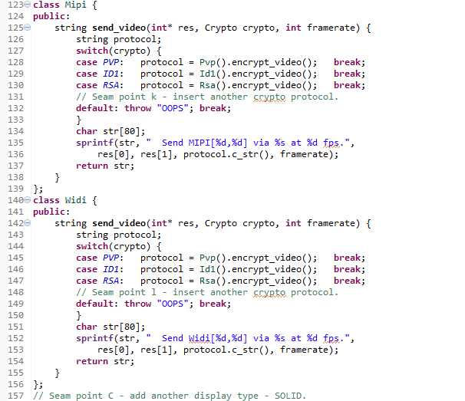
Example Problem
Notes:
Similar conditionals are a code smell.

Slide 13
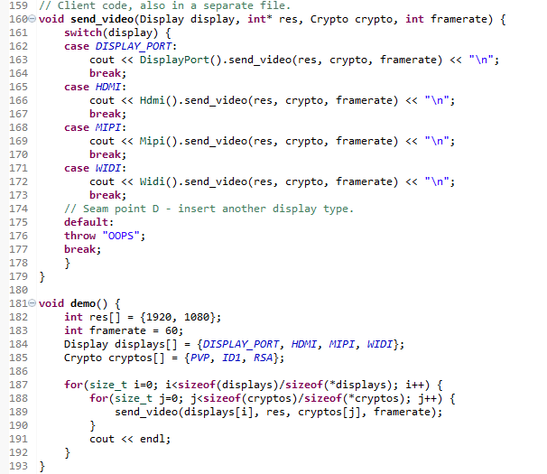
Example Problem
Lots of duplication.
Lots of seam points, worse, the number increases as the number of crypto protocols increase.
Exhibits combinatorial explosion.

Slide 14
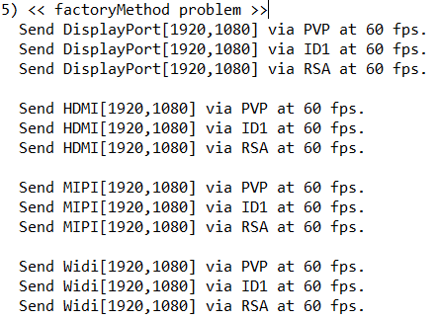
Output

Slide 15
Summary
When the classes are varying, use the Factory Method pattern to encapsulate the variations.
Implement public static method to instantiate base classes.
Typically, all public methods virtual.
Similar switch or if-else blocks a code smell.
Client code should be closed to modification when new classes are added.

Slide 16
Class Progress
If the algorithms are varying
If the interfaces are varying
If the API’s are varying
If the steps are varying
If the classes are varying
If the options are varying
If the listeners are varying
If the responders are varying
If abstract’n & implement’n vary
If the families are varying
Use the Strategy pattern
Use the Adapter pattern
Use the Facade pattern
Use the Template Method pattern
Use the Factory Method pattern
Use the Decorator pattern
Use the Observer pattern
Use Chain of Responsibility pattern
Use the Bridge pattern
Use the Abstract Factory pattern

Slide 17
Backup Slides

Slide 18
